Slide 1
Personal Optional Protection Quiz
Annie Student

Slide 2
Instructions
Go the WorkSafe BC website.
Watch the Audio Slide Show titled “Personal Optional Protection – Leigh Kitsch.”
Proceed through the quiz questions in this slideshow.
Clicking on a slide will reveal the correct answer.
You can also find the WorkSafe BC site at: http://www2.worksafebc.com/Publications/Multimedia/Slideshows.asp.

Slide 3
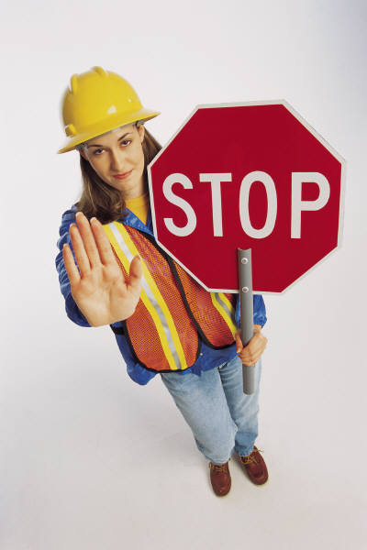
Are you ready?
Don’t go any further until you’ve watched the Personal Optional Protection presentation.

Slide 4
Question 1
Which of these people would be the best candidate for Personal Optional Protection?
A. Factory workers
B. Unemployed people
C. Summer students
D. Self-employed people
Click anywhere to see the correct answer

Slide 5
Question 2
What reason does Leigh give for signing up for POP?
A. Low Premiums
B. Protection in case she is unable to work
C. Prevents her business from being sued
D. A friend recommended it
Click anywhere to see the correct answer

Slide 6
Question 3
Which of these wasn’t one of the potential hazards listed for a laser hair removal salon?
A. Chemical burns
B. Repetitive stress
C. Eye damage
Click anywhere to see the correct answer

Slide 7
Questions 4-10
You can use other techniques as well...
Including adding images
Using other question types
Fill in the blanks
Matching
T/F
Try to give your quiz a polished and uniform look. Don’t make every slide look completely different.

Slide 8
The End
Thanks and be safe!

